Slide 1
CLIENT SUBSCRIPTION PREDICTION AND CLIENT SEGMENTATION
Mentor: Mr. Sourab Reddy
Team members:
Abhinav M K
Akshaya G V
Chandrahas
Jeevesh Pachouri

Slide 2
Problem Statement
During the Global Financial Crisis in 2008, the Portuguese banks were pressured to capture more long term deposits to increase the capital requirements. A telemarketing campaign was conducted in this regard and the data is collected from 2008-2013.
Project Objective:
Predict client subscription to the term deposit.
Segmenting clients to tailor the marketing campaign for the potential clients.

Slide 3
Data description
Age
Job- type of job
Marital- marital status
Education
Default- Is credit in default?
Balance- average yearly balance (in euros)
Housing- has a housing loan?
Loan- has a personal loan?
Contact- communication type
Day- last day of contact
Month- last month of contact
Duration- duration of last contact (in seconds)
Campaign- number of contacts performed during this campaign and for this client (includes the last contact)
Pdays- number of days that passed by after the client was last contacted from a previous campaign (-1 means the client was not previously contacted)
Previous- number of contacts performed before this campaign and for this client
Poutcome- the outcome of the previous marketing campaign
y - has the client subscribed to a term deposit?

Slide 4
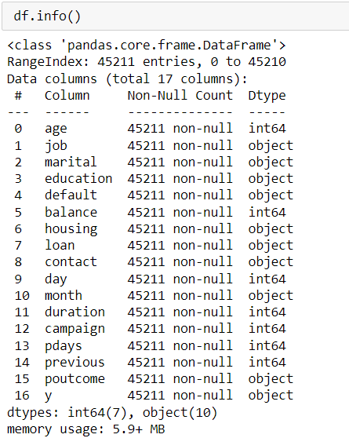
Categorical columns (10): job, marital, education, default, housing, loan, contact, month, poutcome, y
Numerical columns (7): age, balance, day, duration, campaign, pdays,previous

Slide 5
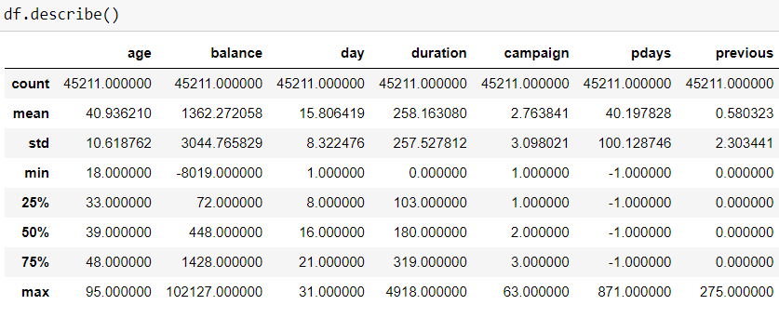
Inferences of numerical data
Age ranges from 18-95
Balance also has negative values.
Most contacts are made on day 20.
On an average the duration of the calls exists for 258 seconds.
Normally a client would be contacted 2 times.
Most of the clients were never been contacted for the previous campaign.

Slide 6
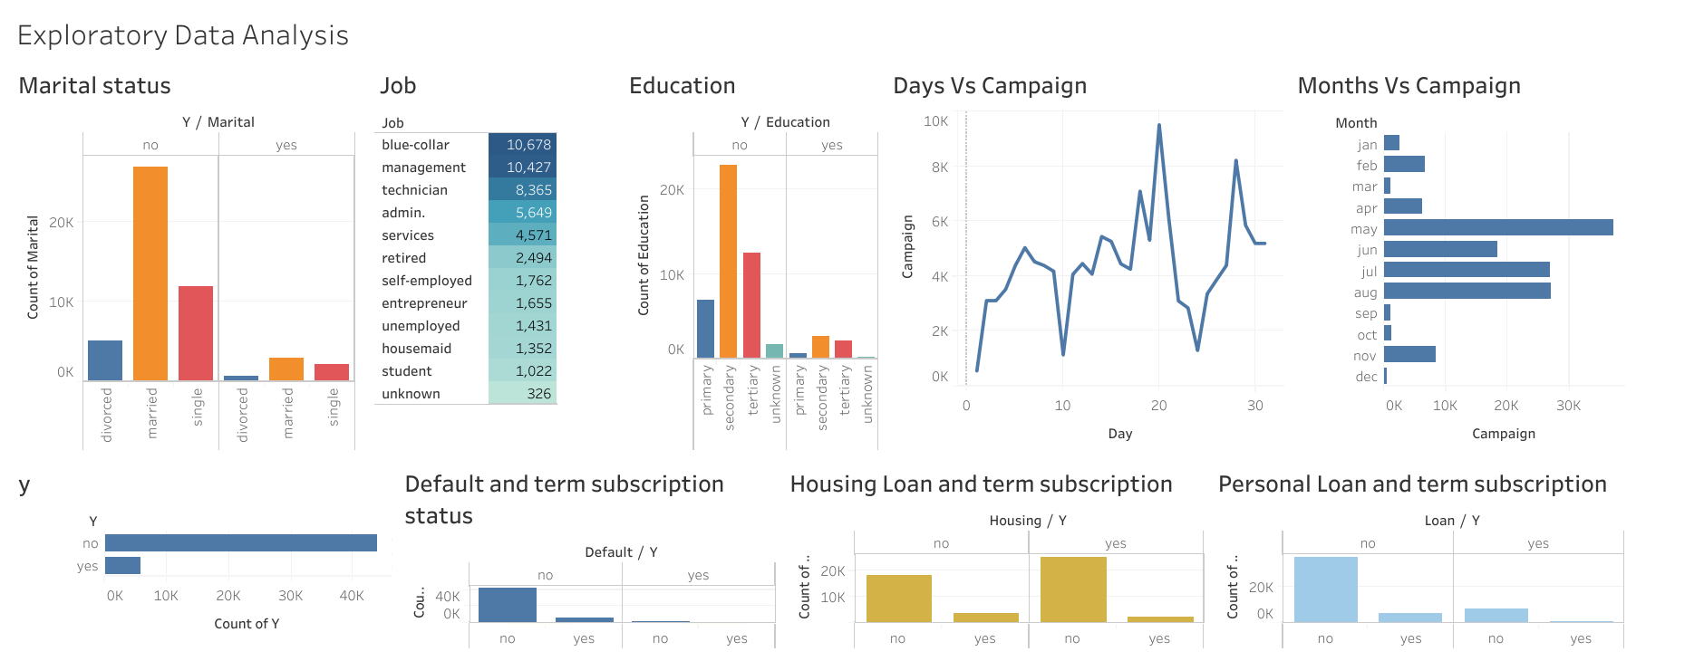

Slide 7
The target variable is imbalanced.
Clients in management role are high in number for taking the subscription.
Married clients are also high in number for taking the term subscription.
More marketing campaigns are conducted in the month of May and minimum number in December.
This client data have less number of defaulters. Most of the non-defaulters have taken the term subscription.
Over 50% of the clients have housing loan. A significant number of clients with housing loans have also taken up the term subscription.
Most of the people who have taken the term deposit have no loan. But this category is also high for not subscribing.

Slide 8
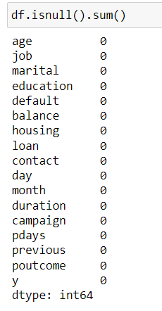
Imputing unknown values
Unknown entries in job is replaced as student after comparing the balance ranges of the job categories.
Based on each job, the unknown in education is replaced with mode of the education.
As the unknown entries in poutcome and contact are more in number, poutcome and contact columns are dropped.

Slide 9
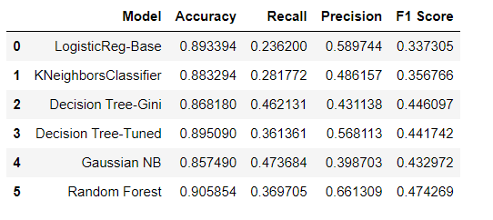
Base model building
The dataset consists of imbalanced classes.
F1 score is used to evaluate the models.
The imbalance was treated using SMOTE and Upsampling.

Slide 10
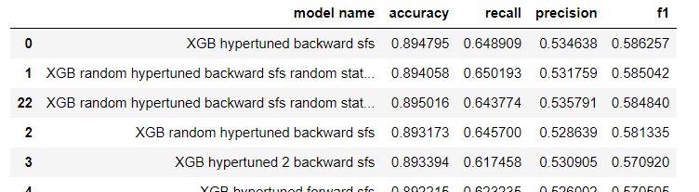
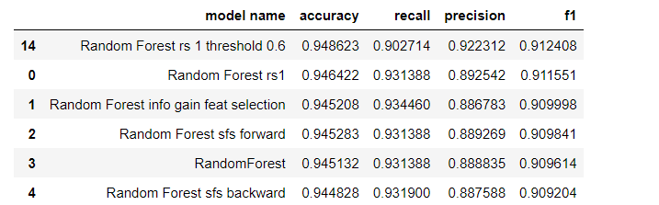
After SMOTE
Upsampling

Slide 11
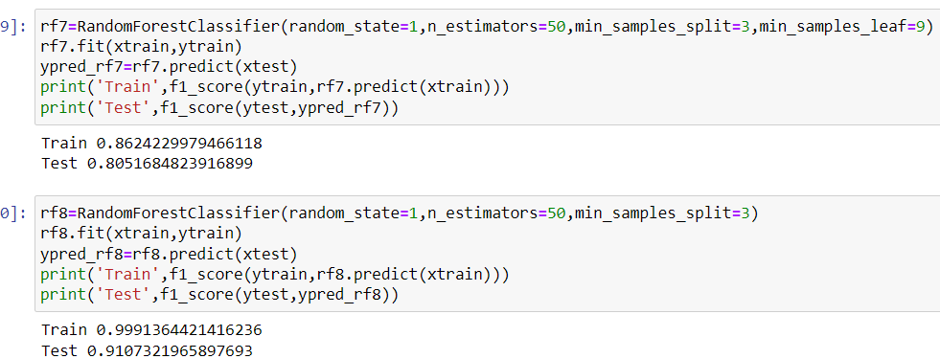
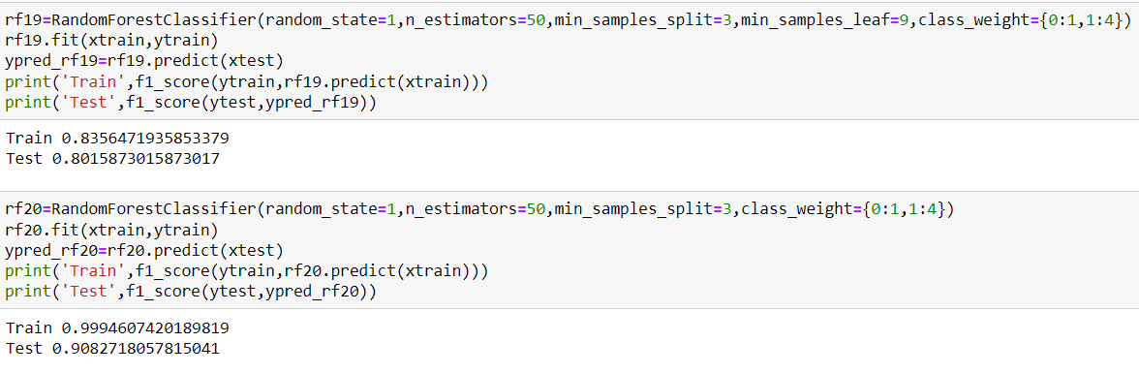
All the 4 models are overfitting. RF 19 is finalized for the less difference between train and test f1 scores.

Slide 12
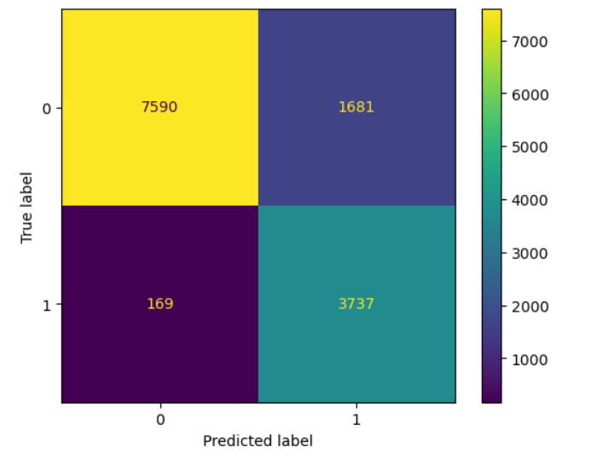
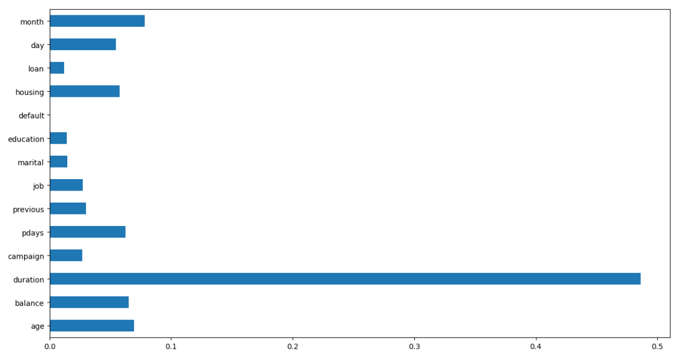
Duration has the highest importance score (0.486), suggesting it is the most influential feature in making predictions. month (0.078), age (0.069), and balance (0.065) also have notable importance.

Slide 13
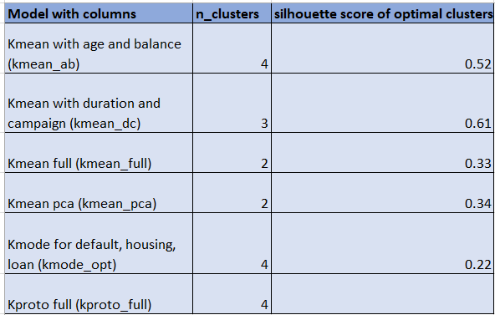
Customer Segmentation
Clustering algorithms like KMeans, KModes, and Kprototypes were performed on the data.
KMeans algorithm was performed on age-balance, duration-campaign, all numeric columns, and PCA of all numeric columns.
KModes on default-housing-loan.
KPrototypes on entire data.

Slide 14
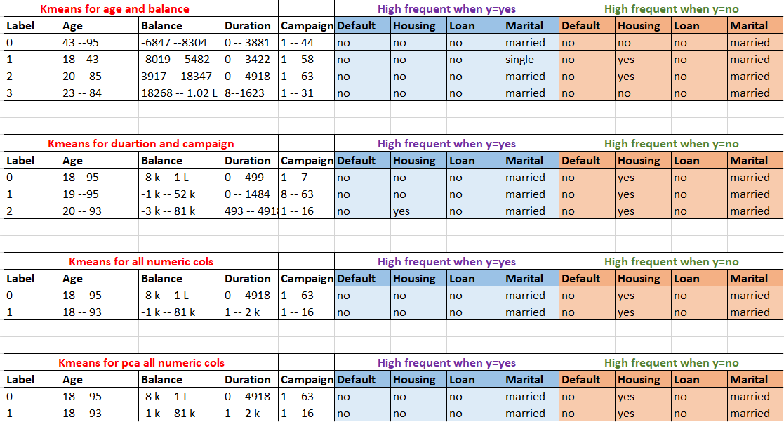

Slide 15
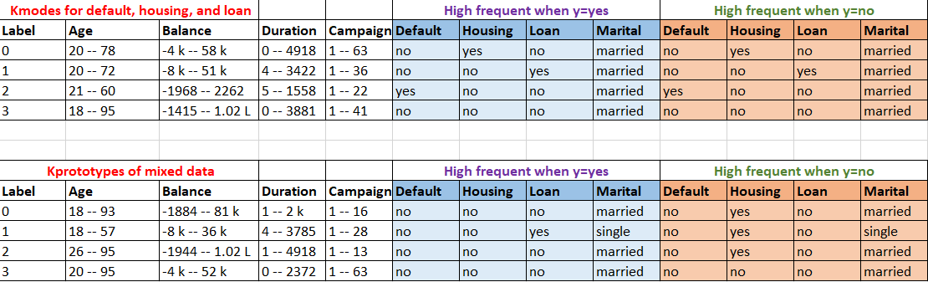

Slide 16
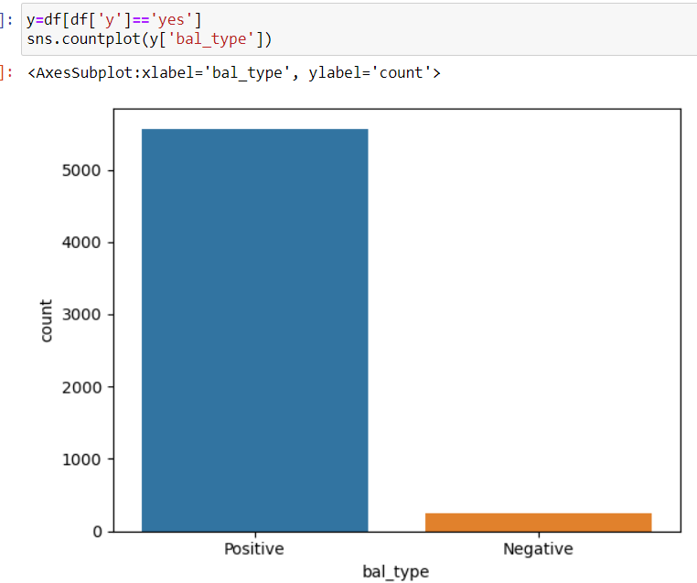
Business Recommendation
All ages are suitable for the term deposit.
Targeting customers with high average balances.
Focus the marketing campaign during the months of March, September, October and December.
Clients with no default, no personal loan, and may or may not with housing loan are potential clients for the subscription.
Clients who had call durations above average are likely to take up the subscription.

Slide 17
Limitations
The data was highly imbalanced. In 45K client data, almost 5000 clients have subscribed to the term subscription and the rest have not subscribed to the term deposit.
There were more missing values in previous outcome and mode of communication data.
More data are needed to understand why people with loans, defaults, and negative balances opted for the term deposit.
It is unclear on why the subscription rate is higher on 20th day and May month has the highest subscription.
There are less data about customers who under the age category 90s.

Slide 18
Thanks!

